Slide 1

Bank Loan Analytics
Presented by Group 3

Slide 2
Team Members
Rinku
Gowtham
Ashish
Anji
Pavani
Promoth
Ankan

Slide 3

Introduction
This project is an in-depth analysis of bank loan data, aimed at uncovering key insights into loan issuance trends, customer credit behavior, and financial performance metrics. The analysis combines SQL, Tableau, Excel and Power BI for data extraction and transformation into data visualization, providing a comprehensive overview of loan trends over time, the financial health of different customer segments, and risk assessment across various loan grades. This project serves as a crucial tool for understanding the dynamics of loan portfolios and guiding strategic decision-making in the financial sector.

Slide 4





Tools
Microsoft Excel
Microsoft Power BI
Tableau
MySQL

Slide 5
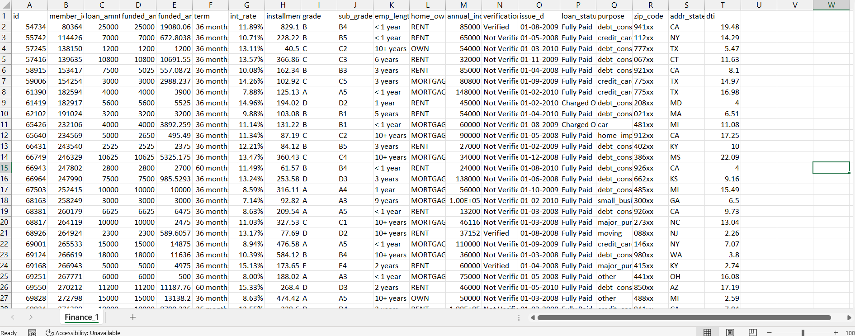
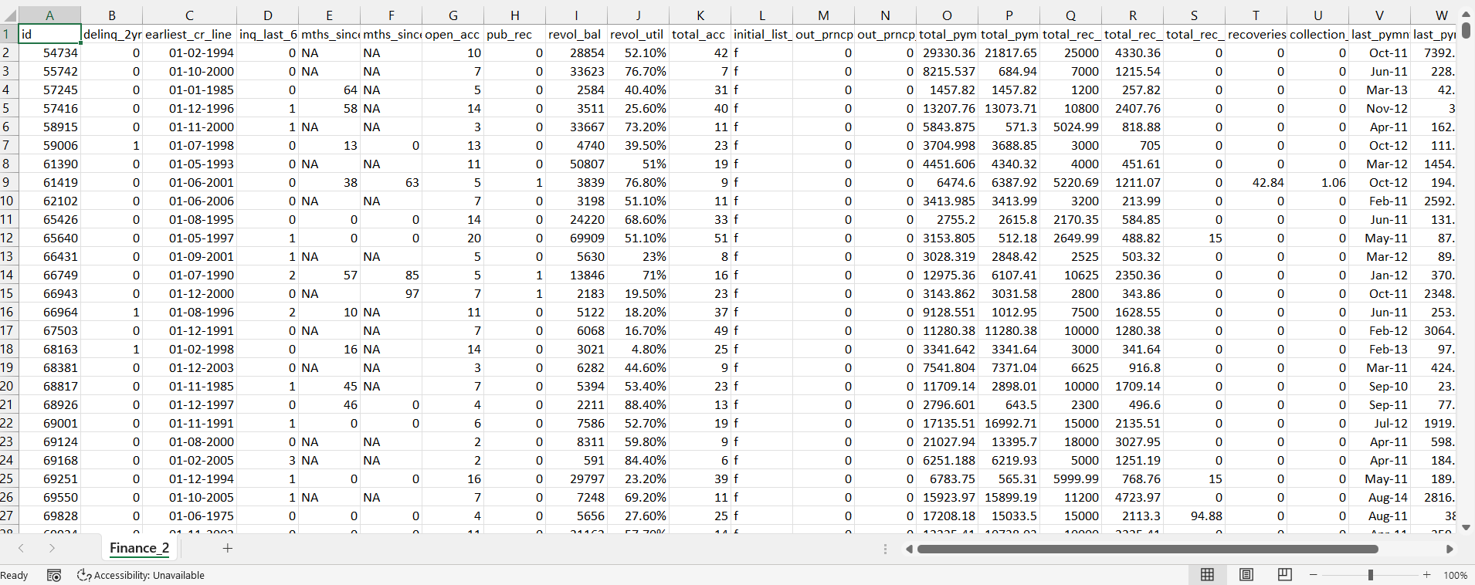
Datasets
Finance_1 and Finance_2 are the two datasets used for analysis.

Slide 6
Data Cleaning
Removing redundant columns:- desc, payment_plan, title, emp_title these unnecessary columns were deleted
Data types:- “issue_date” column in finance_1 sheet was changed to “dd-mm-yyyy” format.
Null values:- “emp_title” column had many null values, so this column was completely deleted from the database.
These data cleaning steps were crucial to ensure relevance of data and give accurate results for further analysis.

Slide 7
KPI’s addressed
KPI 1 :- Year Wise Loan Status
KPI 2 :- Grade & Sub-Grade Wise Revolving Balance
KPI 3 :- Total Payment for Verified Status Vs Total Payment for Non-Verified Status
KPI 4 :- State Wise & Month Wise Loan Status
KPI 5:- Home Ownership by Last Payment Date Stats

Slide 8
Our Findings
Total Loan Amount
$ 445.60 M
Average Interest Rate
12.02 %
Total Fully Paid Customers
32,950
Total Customers
39,717

Slide 9

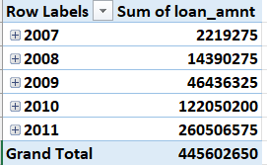
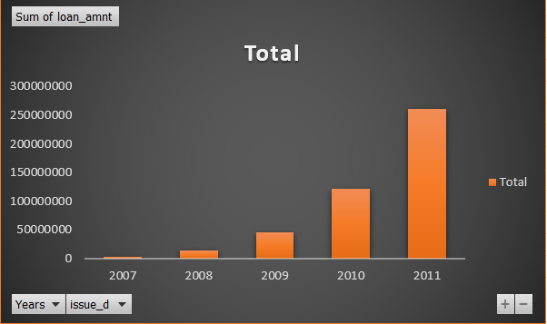
KPI 1 :- Year Wise Loan Amount Status
The chart indicates significant increase in the total sum of loan amounts issued from 2007 to 2011.
There’s just noticeable increase in loan amounts from 2007 to 2009. The most dramatic growth occurs between 2010 and 2011 where the total loan amount doubles itself.

Slide 10

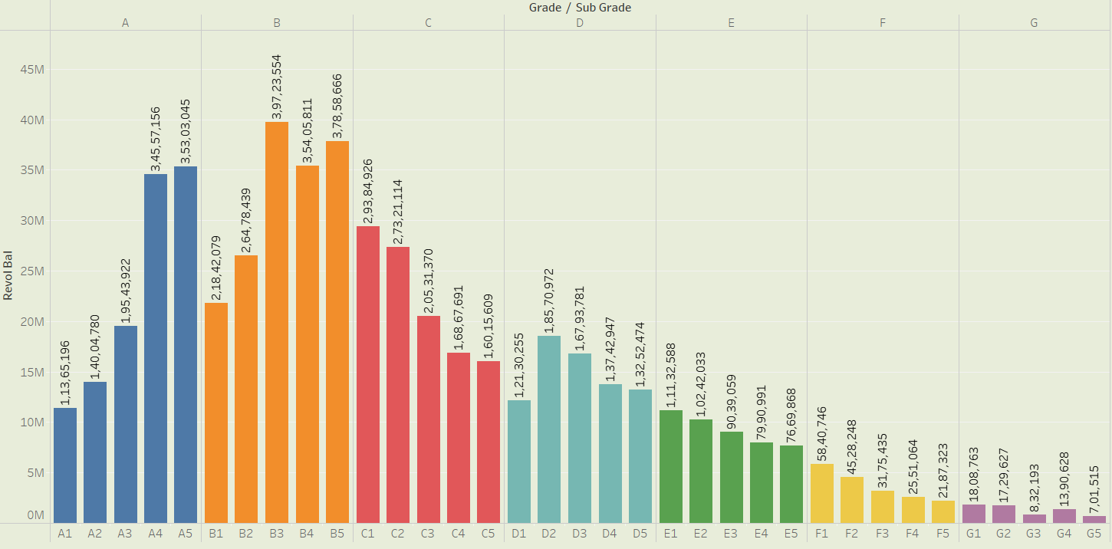
KPI 2 :- Grade/ Sub-Grade Wise Revolving Balance
The chart indicates that Grade A and Grade B have the highest total revolving balances, with subgrades A4,A5 being the highest in grade A. Similarly, B3,B4,B5 in Grade B.
On the contrary, Grade F and G are having the lowest revolving balances with F5 and G5 being the lowest in their respective grades.

Slide 11

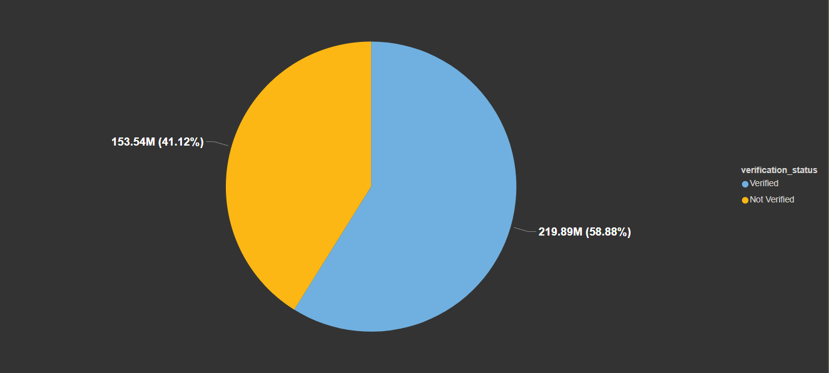
KPI 3 :-Verified & Non-Verified Payments
More than half of the total population or dataset is verified, indicating a higher rate of verification overall.
While majority of the percentage is verified still a little more than 40% is unverified indicating that there’s a room for improvement in the verification process

Slide 12
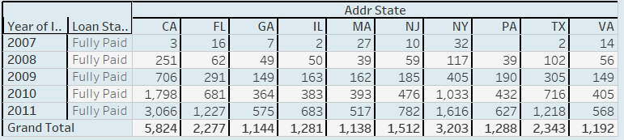
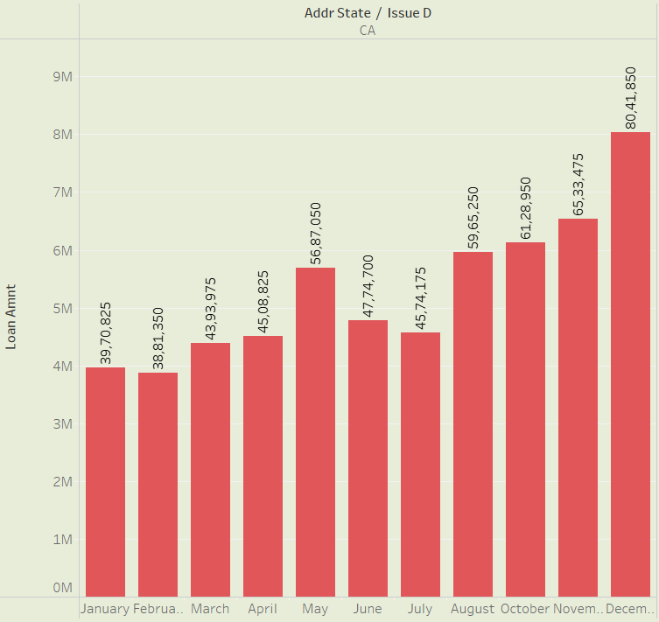
KPI 4 :- State & Month wise loan status
The above table shows the total count of fully paid loan amount across 10 states.
We can observe that California has the highest count followed by New York and Florida.
The picture below further analyses the state California for month-wise fully paid amount status showing us the quantitative loan amount.
December has recorded the highest fully paid loan amount in California.

Slide 13

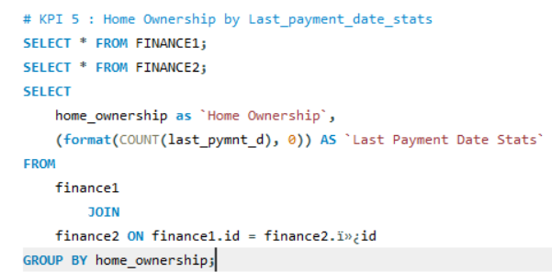
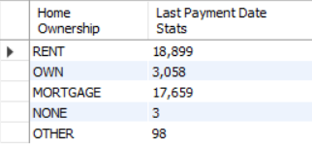
KPI 5 :- Home ownership by last payment date
Renting is the most common category among individuals having count of 18,899.
Mortgage holders are the second largest group having 17,659.
Combining mortgage(17,659) and own(3,058) categories shows that 20,717 individuals have some form of home ownership
These high number of mortgage indicates that a substantial portion of population has long-term financial commitments related to housing.

Slide 14
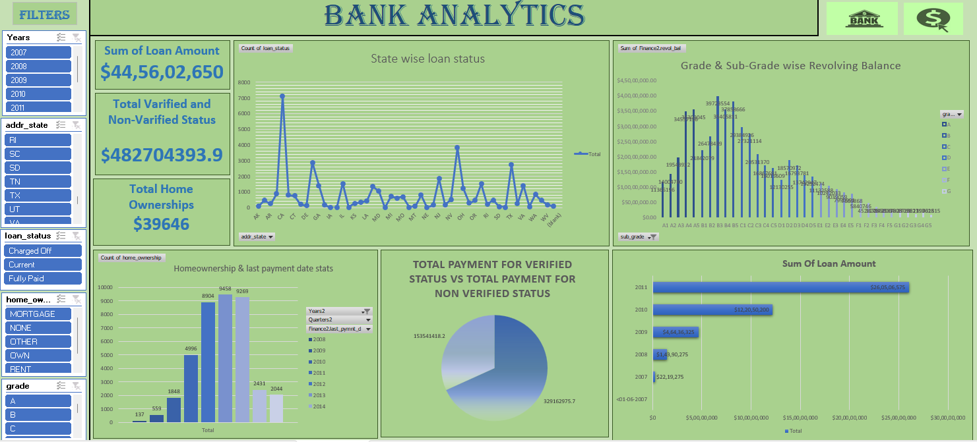
Excel Dashboard

Slide 15
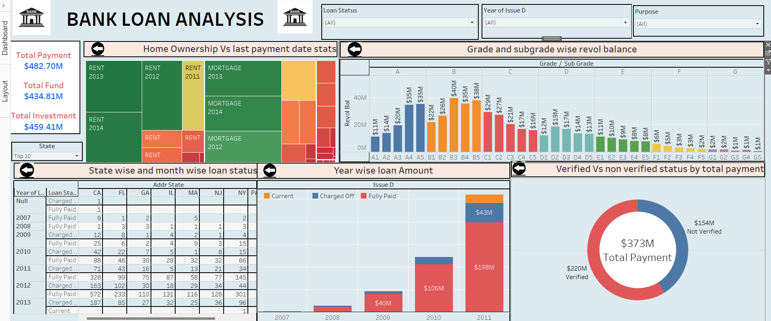
Tableau Dashboard

Slide 16
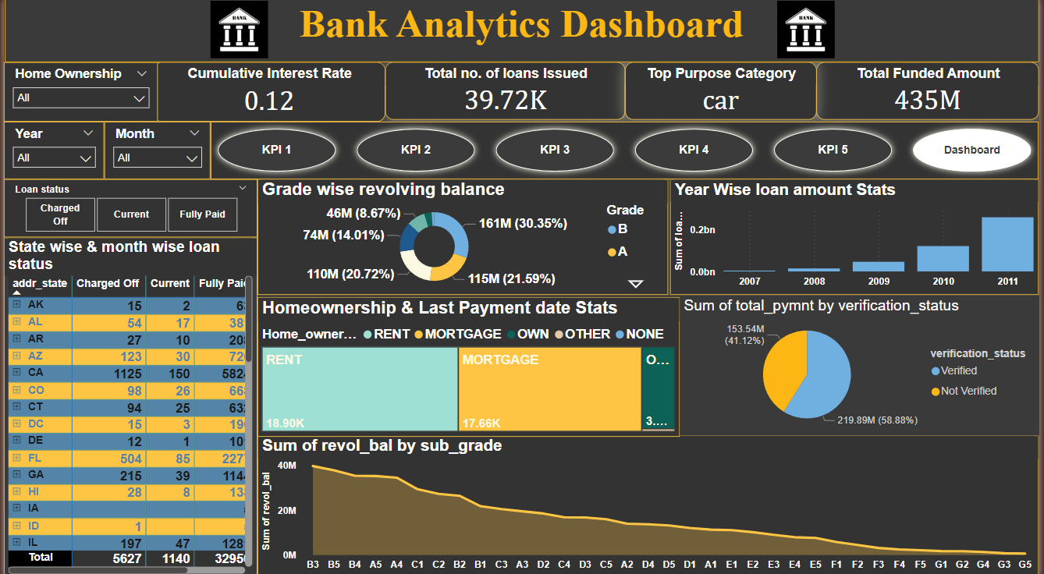
Power BI Dashboard

Slide 17
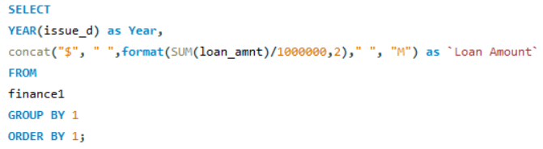
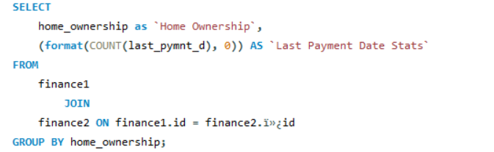
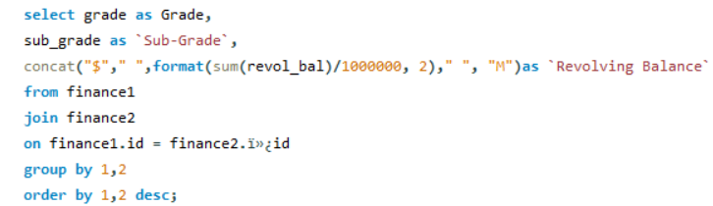
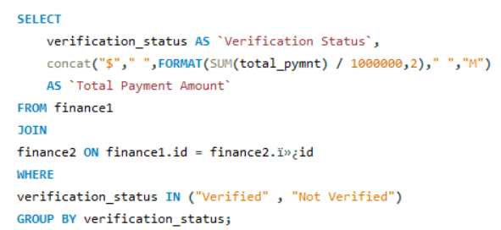
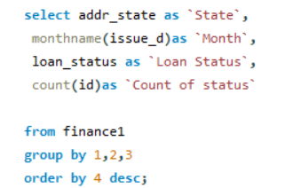
MySql Dashboard
KPI 1
KPI 5
KPI 3
KPI 2
KPI 4

Slide 18


